Slide 1
Mesh CURRENT (Loop) &
NODAL VOLTAGE Analysis

Slide 2
INTRODUCTION
Branch currents and branch voltages in a network can be found by the application of ohms law, KCL and KVL.
For the solution of complicated networks the direct application of these basic methods is laborious.
Mesh-current and node-voltage methods reduce the number of unknown variables and the number of simultaneous equations needed to describe a network.
Nodal analysis by applying KCL at each non-reference node.
Loop analysis by applying KVL around loops in the circuit.
Loop (mesh) analysis results in a system of linear equations which must be solved for unknown currents.

Slide 3
Mesh CURRENT (Loop) Analysis A mesh is defined as a closed path around a circuit that does not contain any other closed path within it.
4 Ω
10 Ω
+
–
+
–
V ₁ = 6 V
V ₁ = 8 V
5 Ω
For the above network, find the current flowing through the 5 Ω
Resistor using mesh analysis.

Slide 4
Steps of Mesh Analysis
Identify mesh (loops).
(number of loop = number of equations)
2. Assign a current direction to each mesh (clock or anti-clock wise).
3. Apply KVL around each loop to get an equation in terms of the loop currents.
4. Solve the resulting system of linear equations using Cramer’ rule .

Slide 5
1. Identifying the Meshes
4 Ω
10 Ω
+
–
Mesh 1
Mesh 2
+
–
V ₁ = 6 V
V ₁ = 8 V
5 Ω
number of loop = number of equations
2=2

Slide 6
2.Assign a current direction to each mesh. (clock or anti-clock wise)
+
4 Ω
–
+
10 Ω
–
+
–
+
–
+
–
V ₁ = 6 V
V ₁ = 8 V
I₁
I₂
–
+
5 Ω
Mark the polarity for passive components present in the circuit.

Slide 7
Voltages from Mesh Currents
+
V_{R}
–
+
V_{R}
–
I₂
R
R
I₁
I₁
V_{R} = I₁ R
V_{R} = (I₁ - I₂ ) R

Slide 8
3.KVL Around Mesh 1
4Ω
10Ω
+
–
+
–
+
–
V ₁ = 8 V
+
–
+
–
5 Ω
V ₁ = 6 V
I₁
I₂
–
+
-4 I₁ - 5(I₁ - I₂) + 8 = 0
-4 I₁ - 5I₁ + I₂ + 8 = 0
8=9 I₁ - 5I₂
1

Slide 9
3.KVL Around Mesh 2
4Ω
10Ω
+
–
+
–
+
–
V ₁ = 8 V
+
–
+
–
5 Ω
V ₁ = 6 V
I₁
I₂
–
+
-10 I₂ - 6 - 5(I₂ – I₁) = 0
-10 I₂ - 6 - 5I₂ + 5I₁ = 0
-15 I₂ - 6 + 5I₁ = 0
-6 = - 5I₁ + 15I₂
2

Slide 10
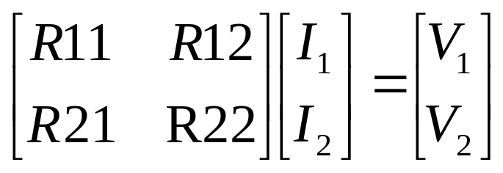
Matrix Notation
The two equations can be combined into a single matrix/vector equation.
8=9 I₁ - 5I₂
-6 = - 5I₁ + 15I₂

Slide 11


Slide 14
ECE201 Lect-10

Slide 15
ECE201 Lect-10

Slide 16
ECE201 Lect-10

Slide 17
ECE201 Lect-10

Slide 18
ECE201 Lect-10

